Slide 1
REVENUE PERFORMANCE
Category Revenue
Performance Dashboard
Camping Equipment · Mountaineering Equipment · Outdoor Protection — via chiclet slicer
Power BI · Filterable by Year & Category

Slide 2
OVERVIEW
Project Overview
CHICLET SLICER
1
One Page, Three Categories
Camping Equipment
A chiclet slicer switches every visual between Camping Equipment, Mountaineering Equipment, and Outdoor Protection.
2
Fully Filterable
Mountaineering Equipment
Slice by Year and Category chiclet to move from company-wide down to a single product.
3
Built for Fast Answers
Outdoor Protection
KPI cards, monthly trend, top products, and retailer breakdowns refresh instantly per category.
Example view: Outdoor Protection selected
Category Revenue Performance Dashboard
2

Slide 3
THE CHALLENGE
Business Problem
Revenue spans three categories, many products, retailer cities, and channels — making it hard to see where revenue and profit are actually concentrated in each line.
Is revenue growing or shrinking by category, and is it seasonal?
Which products actually drive revenue and profit in each category?
Are customers buying proactively or urgently?
Which retailer cities & channels deserve more investment?
Result: category and channel decisions made without clear visibility into where revenue is really coming from.

Slide 4
GOALS
Project Objectives
1
Track Revenue, COGS, Profit & Margin per category
2
Identify top-performing products per category
3
Understand monthly revenue seasonality
4
Segment revenue by purchase urgency
5
Benchmark retailer cities & channel types
6
Deliver one slicer-driven, self-service view
Category Revenue Performance Dashboard
4

Slide 5
DATA
Datasets
S
Sales / Orders
Product, Category, Revenue, COGS, Profit, Month, Year
R
Retailers
Retailer City, Retailer Type, Revenue, Profit
U
Purchase Context
Urgency Flag (Urgent / Not Urgent), Revenue by Urgency
Category Revenue Performance Dashboard
5

Slide 6
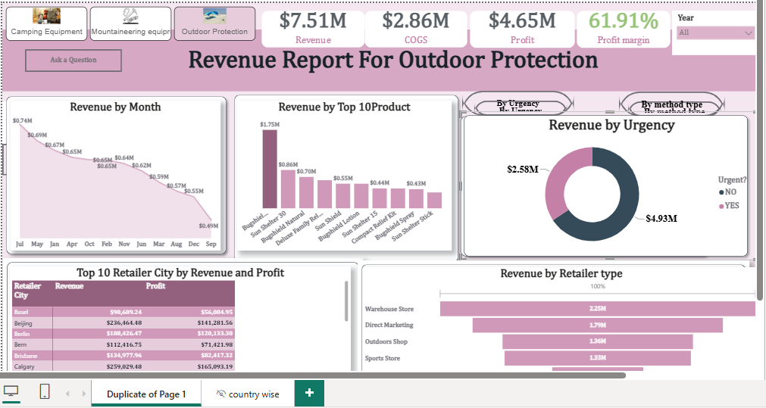
DASHBOARD PREVIEW · OUTDOOR PROTECTION CHICLET SELECTED
Category Revenue Performance Dashboard
Click a different chiclet (Camping / Mountaineering) and every visual updates for that category

Slide 7
PERFORMANCE
KPIs at a Glance
Shown for the Outdoor Protection chiclet — figures update per category selected
$7.51M
$2.86M
$4.65M
61.91%
Revenue
COGS
Profit
Profit Margin
Category Revenue Performance Dashboard
7

Slide 8
FINDINGS
Business Questions & Insights
Worked example using the Outdoor Protection chiclet
Peak month?
Top product?
July leads at $0.74M, declining to $0.49M by Sept
Leading item hits $1.75M — 2x the #2 product
Urgent or planned?
Top retailer city?
65.6% non-urgent ($4.93M) vs 34.4% urgent ($2.58M)
Calgary leads: $259K revenue, $165K profit
Top channel?
Warehouse Store leads at $2.25M revenue
Category Revenue Performance Dashboard
8

Slide 9
SO WHAT?
Business Insight
61.91% margin shows strong pricing power in this category
Clear seasonality — revenue peaks in July, fades by September
Top product carries outsized weight — a concentration risk
~66% of revenue is planned, not emergency, purchasing

Slide 10
ACTION
Strategic Recommendations
Plan inventory & promotions ahead of the July peak
1
Diversify beyond the top SKU with mid-tier product pushes
2
Use early-bird offers to pull forward planned purchases
3
Prioritize investment in Calgary & Beijing
4
Grow Direct Marketing, Outdoors Shop & Sports Store channels
5
Category Revenue Performance Dashboard
10

Slide 11
WHAT'S NEXT
Future Improvements
Longer-term moves for the business, beyond the immediate recommendations
→
Expand into categories that offset seasonal dips
→
Develop more hero products to spread revenue risk
→
Build a direct-to-consumer (e-commerce) channel
→
Launch a loyalty program for planned-purchase buyers
→
Deepen presence in high-potential retailer cities
→
Explore private-label & bundled product kits

